Slide 1
Relative Readmission Risk Monitor
Robert Yerex, Ph.D. Senior Data Scientist 08/05/2015

Slide 2
Executive Summary
Objectives. To develop a software application to assist ACO Care Coordinators in prioritizing intervention efforts allocated to ACO patients discharged within the previous 30 days.
Data Sources. Claim and Claim Line Feed (CCLF) files provided by the Centers for Medicare & Medicaid Services (CMS).
Technology. A predictive model based on statistical learning techniques used to predict a patient’s hazard function across the first 30 days post discharge.
Performance. The most recently trained and tested incarnation of the model had a pairwise concordance index of 0.72 averaged across the first 30 days post discharge.

Slide 3
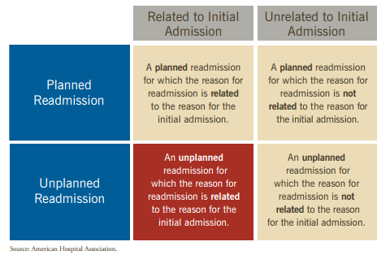
30 Day All Cause Readmission

Slide 4
Use Case
Large Case Load:
Between January 2013 and April 2015, the number of ACO patients discharged within the previous 30 days averaged 386; of whom 47 would experience an unplanned readmission, related to their initial hospitalization, within 30 days of their discharge.
Application:
Provide a list of ACO patients discharged over the previous 30 days in ranked relative order of likelihood of being readmitted less than 30 days post discharge.
Post discharge follow-up intervention reduced utilization by 8.3% ¹
42 minutes per patient
For UVA case load, 9 hrs./ day for follow-up efforts.
¹ Jack, B. W. et al. A Reengineered Hospital Discharge Program to Decrease Rehospitalization. Ann Intern Med 150, 178–187 (2009).

Slide 5
Potential Savings
Profit vs. penalty:
In 2013, estimated profits on “excess” readmissions was $95M, penalties during the same period were estimated at $280M.
Opportunity cost

Slide 6
State of the Art
Domain:
Models to predict 30 day readmission in the US, using retrospective administration data such as CMS Claims Data Feed
Results:
Nine large population-based or multicenter US studies had c-statistics 0.55 – 0.65¹
Models developed by CMS for congestive heart failure, acute myocardial infarction, and pneumonia had c-statistics of 0.61, 0.63, and 0.63, respectively
Human expert based protocols fared even worse with AUC statistics from 0.50 for case managers to 0.59 for interns, 0.56 for Physicians ².
¹ Kansagara, D. et al. Risk Prediction Models for Hospital Readmission: A Systematic Review. (Department of Veterans Affairs (US), 2011). at http://www.ncbi.nlm.nih.gov/books/NBK82578/
² Allaudeen, N., Schnipper, J. L., Orav, E. J., Wachter, R. M. & Vidyarthi, A. R. Inability of Providers to Predict Unplanned Readmissions. J Gen Intern Med 26, 771–776 (2011).

Slide 7
State of the Art
Limiting Factors:
Data:
Modeling methodology:
Feature engineering:
Target
Delivery mechanism

Slide 8
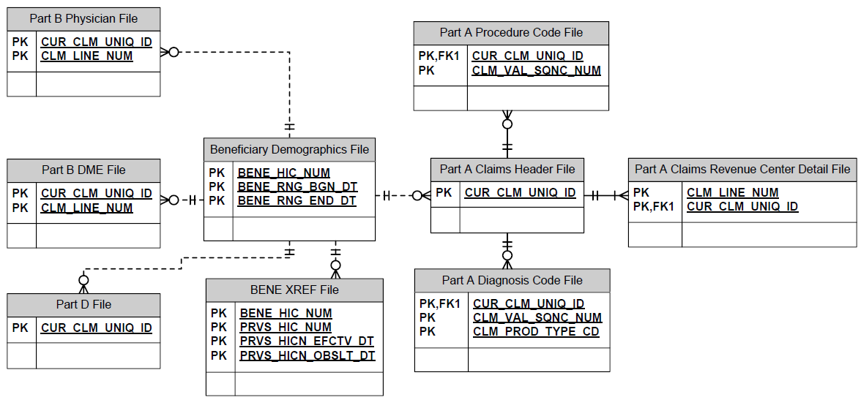
Data – CMS Claims Data Files

Slide 9
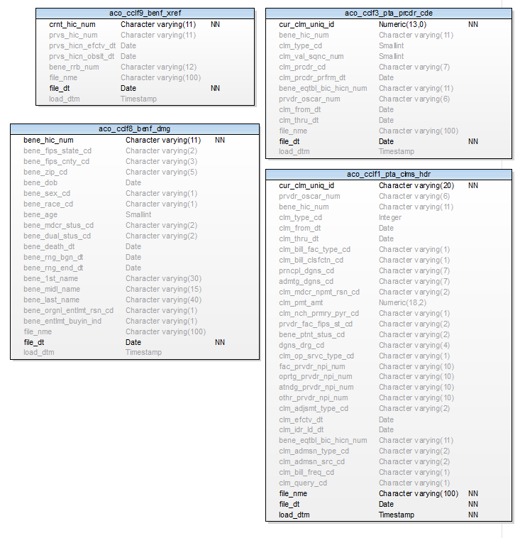
ACO Claims Schema

Slide 10
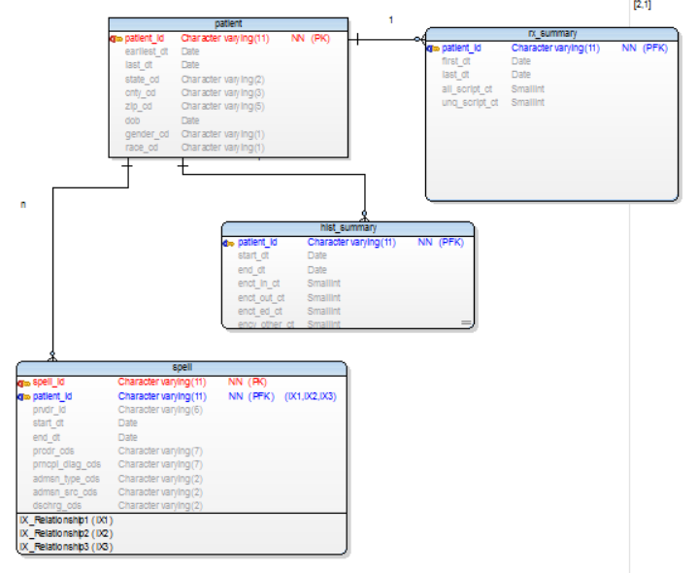
Data – Medical History View

Slide 11
Modeling
Trade off between predictive accuracy and model interpretability
Algorithmic / Statistical Learning based models are more accurate, less interpretable
Interpretability
Predictive Accuracy
Human Expert Logistic Regression Random Forest SVN NN

Slide 12
Feature Engineering
Basic Features:
Demographics, utilization, diagnostic history
Additional Features:
Socioeconomic (median income, education), accessibility of care (distance to PCP, density of care facilities/practitioners)
Engineered Features:
Dimensionality reduction (combinations of ICD-9 codes),
Pathway features (complexity of discharge sequence)

Slide 13
Discharge Pathways
Home
Long Term
Hospice
Org Home HC
Hospital
Deceased
SNF
SNF
IRC
ICF
IRC
Other Hospital
ICF
¹ Coleman, E. A., Min, S., Chomiak, A. & Kramer, A. M. Posthospital Care Transitions: Patterns, Complications, and Risk Identification. Health Serv Res 39, 1449–1466 (2004).

Slide 14
Target
Classification Models:
30 day readmission Yes/No
Survival / Hazard Models:
Generate a predicted hazard rate by post discharge day.
Calculate cumulative remaining hazard
where
and

Slide 15
Accuracy

Slide 16
Process - Training
ACO Data Files
Scoring
Testing
Training
Train / Test Data Set
ETL
Patient History Database
Feature Extraction
Diagnoses Procedures

Slide 17

Process - Scoring
Daily Discharge Data Set
Ranked List of Patients Discharged in Past 30 Days
Feature Extraction
EPIC
Scoring
Scoring Data Set
Patient History Database

Slide 18
Implementation Plan
Model Development & Retrospective Testing Complete
“Silent” Prospective Testing
Train on most recent CMS Claims Data
Score discharged patients on a daily basis
Analyze predicted and actual results to measure true accuracy
Next Steps / Timing:
Epic backend integration: daily discharge data set
30 days after resource identified and assigned
Silent Test:
Does not require integration of scored output into Epic
120 days after Epic backend integration
Analyze results
Epic frontend integration: application to present daily ranked list to Care Coordinators
?, Resource capable of Epic integration application development
Overall five to six months after project kickoff and resource assignment.

Slide 19
Aug
Sep
Oct
Nov
Dec
2016
2016
Today
8/10/2015
10/1/2015
1/18/2016
Kick-off
Identify and assign Epic frontend application developer
Complete Epic frontend application development
9/28/2015
Initiate prospective scoring
1/11/2016
Present pilot results
9/21/2015
1/4/2016
Complete Epic backend integration
Analyze pilot results
2015
8/17/2015
Identify & assign Epic backend integration resources

